Slide 1

ECE 2700
Digital Circuits
Exam III Review

Slide 2
HLSM
High-level state machine
RTL design process
  Create HLSM
  Convert to datapath and controller (FSM)
Differences between FSM and HLSM
  FSM operates on single bits, no storage, no arithmetic operations
  HLSM operates on multiple bits, has storage, can perform arithmetic calculations

Slide 3
HLSM Example
Create the following HLSM
  The machine sequentially reads 32 positive numbers from a 32x64 register file and outputs L, which is the length of the longest sequence of identical values
Example
  Sequence = {0 1 5 4 7 3 9 9 2 5 5 5 8 8 1}
  L = 3
    Due to three consecutive 5’s
Register file is outside the datapath
  Assume no delay when reading

Slide 4
C-Like Code
last = -1;
currLength = 1;
longest = 1;
for (i=0; i<32; i++)
{
data = A[i]; //A is the register file
if (data == last)
{
currLength = currLength + 1;
if (currLength > longest)
{
longest = currLength;
}
}
else
{
last = data;
currLength = 1;
}
}
Registers needed
  last
  currLength
  longest
  i
  data
  (maybe more…)
W_data
R_data
W_addr
32 x 64
register file
A
R_addr
W_en
R_en

Slide 5
HLSM (One Solution)
data := R_data
init
check
read
getdata
i < 32
last := -1
currLength := 1
longest := 1
i := 0
L := 1
R_en = 1
R_addr := i
i := i + 1
equal?
last == data
(i < 32)’
(currLength
> longest)’
(last == data)’
done
update
currLength
> longest
inc
reset
L := longest
longest := currLength
currLength := currLength + 1
currLength := 1
last := data

Slide 6
Datapath
R_data
-1
1
To/from register file
To/from FSM
0
0
1
+1
System output
1
2x1 mux
data
2x1 mux
s
k
All regs have
ld/clr signals
currLength
last
+1
i
=
longest
R_addr
<
32
>
last_eq_data
L
L
i_lt_32
curr_gt_longest

Slide 7
Top-Level Overview
data_ld, data_clr, last_ld, last_clr, currLength_ld, currLength_clr,
longest_ld, longest_clr, i_ld, i_clr,
L_ld, L_clr
FSM
Datapath (Last Slide)
L
s
k
curr_gt_longest
i_lt_32
last_eq_data
R_addr
Reg File
R_en
R_data

Slide 8


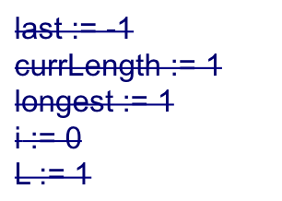
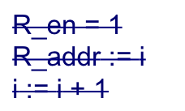









FSM (Finally!!!)
last_ld = 1, s = 0
currLength_ld = 1, k = 0
longest_ld = 1
i_clr = 1
l_clr = 1
data_ld = 1
R_en = 1
i_ld = 1
init
check
read
getdata
i_lt_32
equal?
i_lt_32’
(curr_gt_longest)’
last_eq_data
done
update
inc
reset
last_eq_data’
curr_gt_longest
L_ld = 1
longest_ld = 1
currLength_ld = 1
k = 1
currLength_ld = 1
k = 0, last_ld = 1, s = 1

Slide 9
HLSM to FSM (Controller) & Datapath
Elapsed time calculation
  Given an input button B, you are to calculate C, which is the number of cycles elapsed between 2 button presses. After C is calculated, the system returns to the Init state
  You may not use a timer/counter in your design

Slide 10
Elapsed Time HLSM
B’
B
B
Press1
Count := Count + 1
Wait
B’
B’
Init
B/W Presses
Count := 0
Creg := 0
Count := Count + 1
B
Press2
Creg := Count

Slide 11
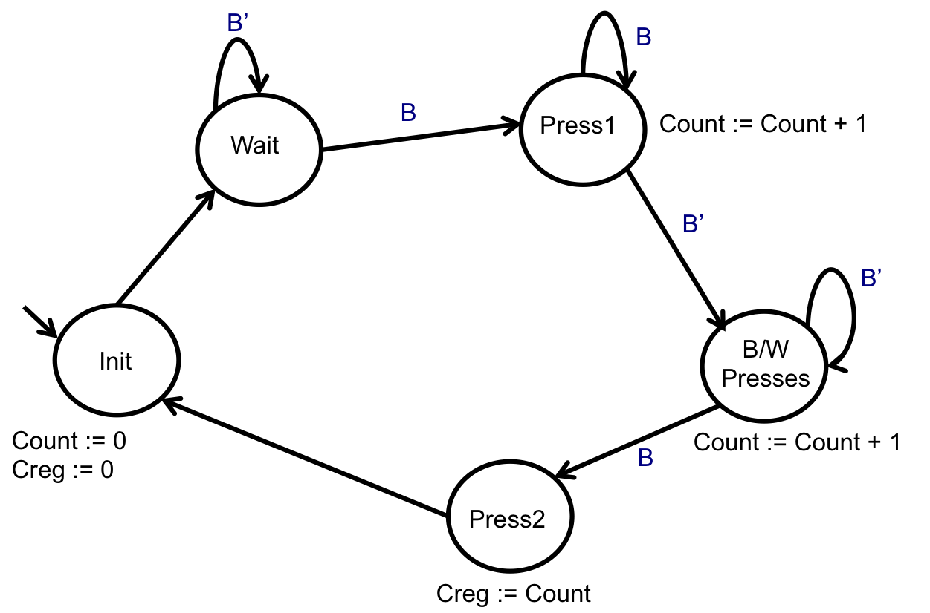
Top-Level Diagram
FSM
Datapath
B
C

Slide 12
Designing the Datapath
Datapath
count_clr
count_ld
count
+1
creg_clr
creg_ld
creg
C

Slide 13
Top-Level Diagram
FSM
Datapath
B
count_ld
count_clr
creg_ld
creg_clr
C

Slide 14
Converting to FSM
SAME
  States
  Transition arcs
  Transition conditions
    If depends on inputs
DIFFERENT
  Transition conditions
    If depends on results from datapath
  Actions at each state

Slide 15
Controller FSM
B’
B
B
Press1
Wait
count_ld = 1
B’
B’
Init
B/W Presses
count_clr = 1
creg_clr = 1
count_load = 1
B
Press2
creg_ld = 1

Slide 16
What if you could use a counter?
B’
B
Wait
B
Press1
B’
B’
counter_enable = 1
Init
B/W Presses
creg_clear = 0
counter_clr = 1
counter_enable = 1
B
Press2
counter_enable = 0;
creg_ld = 1

Slide 17
Mealy to Moore
a’b’ / c = 0
a’b / c = 1
ab’ / c = 1
a’b’ / c = 1
a’b / c = 0
ab’ / c = 0
ab / c = 1
P
Q
ab / c = 0

Slide 18
ALU
Can technically
implement any function
  (xy = 00) S = A + B
  (xy = 01) S = A – B
  (xy = 10) S = A * B
  (xy = 11) S = A’
A
B
A
B
x
ALU
x
y
y
AL-extender
S
I
A
I
B
Adder
cin
I
S
ALU
S
IA = A, IB = B, cin = 0
IA = A, IB = B’, cin = 1
IA = A * B, IB = 0, cin = 0
IA = A’, IB = 0, cin = 0

Slide 19
AL-Extender Implementation
(xy = 00) S = A + B
(xy = 01) S = A – B
(xy = 10) S = A * B
(xy = 11) S = A’
IA = A, IB = B, cin = 0
IA = A, IB = B’, cin = 1
IA = A * B, IB = 0, cin = 0
IA = A’, IB = 0, cin = 0
x | y | cin | IA | IB
0 | 0 | 0 | A | B
0 | 1 | 1 | A | B’
1 | 0 | 0 | A * B | 0
1 | 1 | 0 | A’ | 0
cin = x’y
Can use muxes to implement IA and IB (but can probably do better)

Slide 20
One-Hot Encoding
Number of bits required is the same as number of states
z=0
10000
Off
w=1
z=0
w=0
z=0
First 1
w=0
First 0
01000
00100
w=1
w=0
w=1
z=1
Sec 1
w=0
00010
00001
w=1
w=1
Sec 0
z=1
w=0

Slide 21
Output Encoding
Not possible here since the output at a given state is not unique
z=0
Off
w=1
z=0
w=0
z=0
First 1
w=0
First 0
w=1
w=0
w=1
z=1
Sec 1
w=0
w=1
w=1
Sec 0
z=1
w=0

Slide 22
Two’s Complement Numbers
Represent signed binary numbers
Steps for converting
  Two’s complement numbers to decimal numbers
    If MSB is 1 (MSB is most significant bits)
      Number is negative
      Flips the bits and add a 1
      Convert to decimal to get magnitude
  Decimal numbers to two’s complement numbers
    If positive, convert as usual
    If negative
      Convert to binary
      Flip the bits and add a 1

Slide 23
Question (AP)
Consider a two’s complement number x. If x = 101110, what is its value in decimal?
  -14
  -17
  -18
  46
  None of the above

Slide 24
Signed Numbers
Arrange the following from smallest to largest
  1111
  0101
  1000
  0000
  1010

Slide 25
Signed Numbers
Arrange the following from smallest to largest
  1111
  0101 → positive, value is 2² + 2⁰ = 5
  1000
  0000 → positive, value is 0
  1010

Slide 26
Signed Numbers
Arrange the following from smallest to largest
  1111 → negative, so take the two’s complement:
  -(0000 + 1) = -1
  0101
  1000 → negative, -(0111 + 1) = -1000 = -2³ = -8
  0000
  1010 → negative, -(0101 + 1) = -0110 = 2² + 2¹
  = -6

Slide 27
Signed Numbers
Arrange the following from smallest to largest
In order
  1000 (-8)
  1010 (-6)
  1111 (-1)
  0000 (0)
  0101 (5)

Slide 28
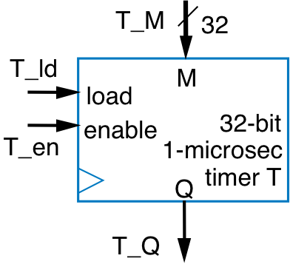
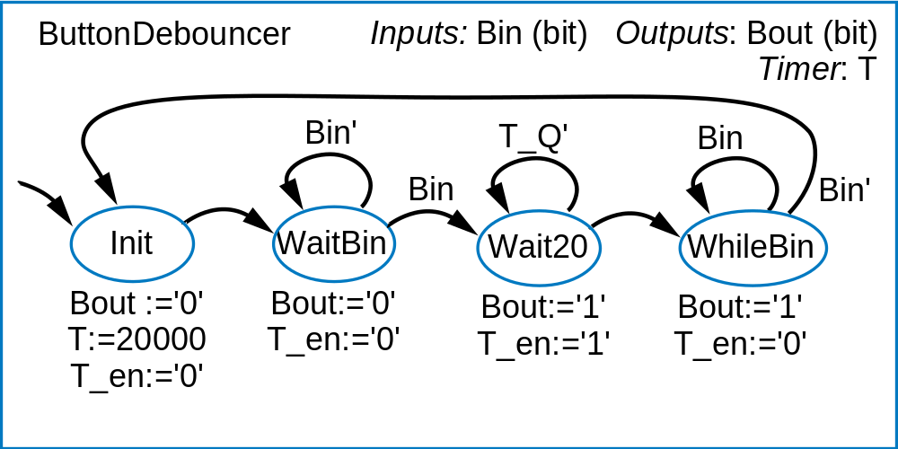
Button Debouncing
button
B
B
0
1
Ideal:
B
Actual:
B
bounce
T_ld:=‘1’
T_ld:=‘0’

Slide 29
Question (AP)
What modification(s) would you need to make to the button debouncing HLSM if the time it takes to stabilize the output is longer than the time the button is pressed?
  Add a state between
  Init and WaitBin
  Add a state between
  WaitBin and Wait20
  Add a state between
  Wait20 and WhileBin
  No change required
  None of the above
T_ld:=‘1’
T_ld:=‘0’

Slide 30
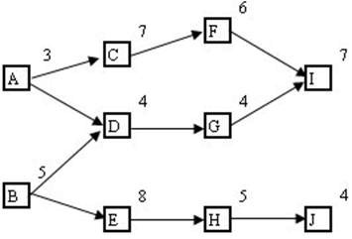
Critical Path
Longest
  Inputs to register
  Registers to register
  Register to output

Slide 31
Memory Components
Type | Construction | Features & Drawbacks
Register file | A collection of registers with drivers and buses | Store several entries of several bits, fast but large, usually more than 1 port
SRAM | Loop of inverters | Slower than register file but smaller, 6 transistors per cell (bit)
DRAM | Capacitor to store charge | Slower but much small, 1 transistor per cell, need periodic recharge
ROM | Depends | Fast reads, slow writes, retain data without power supply
Bigger
Faster
Smaller
Slower

Slide 32
Block Symbols
32
32
32
W_data
R_data
data
10
10
10
W_addr
R_addr
addr
1024
×
32
W_en
R_en
r
w
R
A
M
1024
×
32
Number of entries,
aka number of words
en
register file
32
data
10
1024x32
addr
ROM
Word width or number of bits in an entry
en
Number of entries = 2^{addr_length}

Slide 33
Counter Use
Timer
  When Q is 1, timer goes off
  Q can also be used to automatically reload timer
Clock divider
  From faster to slower frequency
  Use tc as new clock signal

Slide 34
Design Example
Design an 8-bit counter (with an 8-bit output CC) using two 4-bit counters
4-bit up counter
4
4-bit up counter
4
1
cnt
C
cnt
C
0
clear
tc
0
clear
tc
lower
4 bits
upper
4 bits
8
CC

Slide 35
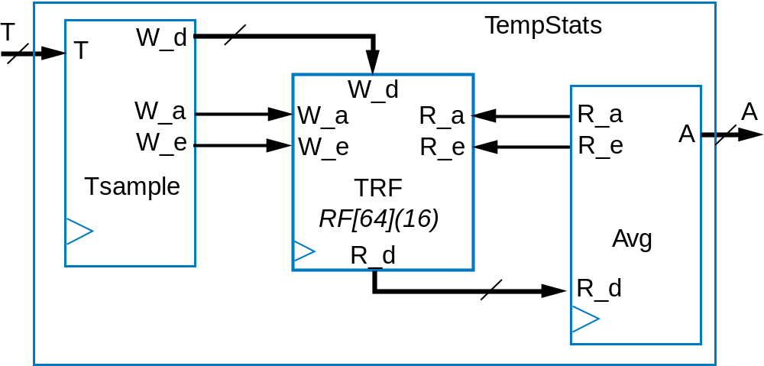
Multiple Processors: Temperature Stats System
Input: T (16 bits), Output: A (16 bits)
Behavior:
  Sample T every 1 second
  Compute A every minute (average of last 64 samples)
Single HLSM → Complicated
Keeping the sampling and averaging behaviors separate leads to simpler design

Slide 36
Register File
W_data
32
32
bus
d0
load
reg0
driver
d0
2x4
32
2x4
d1
load
reg1
d1
W_addr
i0
32
i0
i1
i1
R_addr
d2
load
reg2
d2
write
32
read
decoder
decoder
e
d3
load
reg3
d3
e
W_en
32
R_en
4x32 register file

Slide 37
Register File Example: Write
W_en = 1
W_addr = 01
W_data = 1969
1
01
1969
W_data
32
32
0
1969
d0
load
reg0
d0
2x4
1969
32
1
2x4
d1
load
1969
d1
reg1
W_addr
i0
1969
32
i0
i1
0
i1
R_addr
d2
load
reg2
d2
write
1969
32
read
decoder
0
decoder
e
d3
load
reg3
d3
e
W_en
32
R_en
4x32 register file

Slide 38
Register File Example: Read
R_en = 1
R_addr = 00
1
00
32
16
W_data
32
1
d0
load
16
d0
reg0
16
2x4
32
0
2x4
d1
load
1969
1969
d1
reg1
W_addr
i0
32
i0
i1
0
i1
R_addr
d2
load
0
d2
reg2
0
write
32
read
decoder
0
decoder
d3
load
222
d3
e
reg3
222
e
W_en
32
R_en
4x32 register file

Slide 39
Timing Diagram Example
clk
W_data
15
8
23
1969
0
W_addr
3
0
1
2
W_en
R_addr
0
1
2
3
0
2
R_en
0:
6
Initial register values
1:
10
2:
2
3:
0

Slide 40
Shifting
For base m
  Multiply by m
    Shift left once
  Multiply by m²
    Shift left twice
  Divide by m³
    Shift right three times
When in doubt, think about decimal numbers

Slide 41
Strength Reduction
Let’s say we want to multiply A by 15
  15 A = 8 A + 4 A + 2 A + A
  = A << 3 + A << 2 + A << 1 + A
Assume A is 3 or (0000 0011)₂
A << 3
0000 0011
0000 0110
0000 1100
0001 1000
A << 2
0000 0011
0000 0110
0000 1100
A << 1
0000 0011
0000 0110
A << 3 + A << 2 + A << 1 + A
0001 1000
0000 1100
0000 0110
0000 0011
0010 1101
+

Slide 42
Barrel Shifter
4-bit left
  Can shift left by 0, 1, 2, or 3 positions
16-bit right
  Can shift right by 0, 1, …, 15 positions
To use, set appropriate control bits
  E.g., x, y, z, in
Shifting left 5 times
4
I
1
x
sh
<<4
in
0
4
0
y
sh
<<2
in
0
4
1
z
sh
<<1
in
0
4
Q

Slide 43
Shifter Implementation
4
I
sh
>>2
in
4
Q
in
I3
in
I2
I3
I1
I2
I0
2x1 mux
2x1 mux
1
0
2x1 mux
2x1 mux
1
0
1
0
1
0
sh
s
s
s
s
Q3
Q2
Q1
Q0

Slide 44
Timers
M is the value to count down
from
  M’s unit is in microsecond here
To set, load = 1
Must set enable = 1 for each clock cycle you want the timer to count down
  Setting enable = 0 pauses the timer
Q = 1 when time is up
  After that, the timer dos nothing until load and/or enable signals are again set
32
load
M
enable
32-bit
1-microsec
Q
timer

Slide 45
State Reduction: Partitioned Method
G1: S3, S0, S4
x = 0
S0 → S2 (G2)
S3 → S3 (G1)
S4 → S4 (G1)
G1: S3, S4
x = 0
S3 → S3 (G1)
S4 → S4 (G1)
x = 1
S3 → S0 (G3)
S4 → S0 (G3)
Inputs: x; Outputs: y
x’
x’
S3
x
S0
x
S4
x’
y=0
x’
y=0
x
y=0
x’
x
x
S2
S1
y=1
y=1
G3: S0
Nothing to be done
G2: S1, S2
x = 0
S1 → S4 (G1)
S2 → S3 (G1)
x = 1
S1 → S1 (G2)
S2 → S2 (G2)
Inputs: x; Outputs: y
x’
S3
x
S0
x’
y=0
y=0
x
S2
y=1

Slide 46
Adder & Subtractor
Adder/subtractor: control input determines whether to add or subtract
  Can use 2x1 mux – sub input passes either B or inverted B
  When subtracting, remember to throw away
  the carryout!
B
A
N-bit
0
1
sub
N-bit 2x1
A
B
cin
+
S

Slide 47
Subtractor
Can build subtractor as we built carry-ripple adder
1st
column
2nd
c
olumn
3
r
d
c
olumn
4th
c
olumn
0
0
1
1
0
0
1
0
1
0
1
1
0
1
1
0
1
0
1
1
0
1
0
1
0
1
0
-
0
1
1
1
-
0
1
1
1
-
0
1
1
1
-
0
1
1
1
1
1
1
0
1
1
0
0
1
1
a3
b3
a2
b2
a1
b1
a0
b0
wi
a
b
wi
a
b
wi
a
b
wi
a
b
wi
a3
a2
a1
a0
b3
b2
b1
b0
FS
FS
FS
FS
4-bit subtractor
wi
w
o
s
w
o
s
w
o
s
w
o
s
w
o
s3
s2
s1
s0
w
o
s3
s2
s1
s0

Slide 48
Overflow
Sometimes result can’t be represented with given number of bits
  Either too large magnitude of positive or negative
  Adder/subtractor should indicate when overflow has occurred, so result can be discarded

Slide 49
Overflow Detection
Overflow occurs when the two numbers’ sign bits are the same but differ from the result’s sign bit
  If the two numbers’ sign bits are initially different, overflow is impossible
Simple overflow
detection circuit for
4-bit adder
  overflow = a3’b3’s3
  + a3b3s3’
sign bits
0
1
1
1
1
1
1
1
1
0
0
0
+
0
0
0
1
+
1
0
0
0
+
0
1
1
1
1
0
0
0
0
1
1
1
1
1
1
1
overflow
overflow
no overflow

Slide 50
More Example
Adding two negative numbers (because they start with a ‘1’)
1011
+
1111
1 1010
We always throw away the carry out when adding two signed numbers together, remember?
So the result is 1010, which is also negative, so no overflow

Slide 51
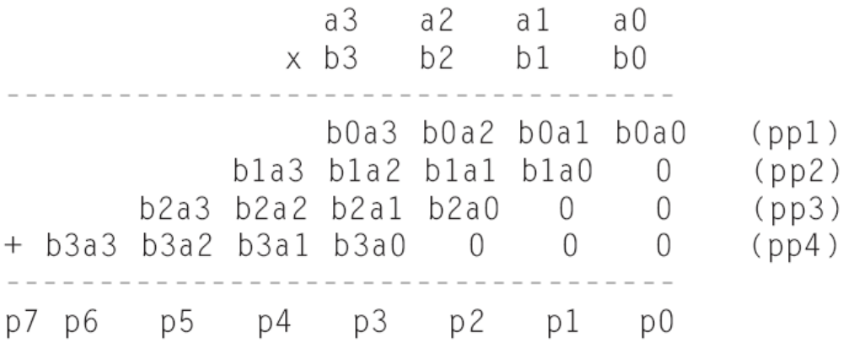
Multiplier Design Idea
Generalized representation of multiplication by hand

Slide 52
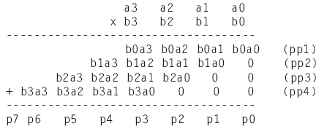
Multiplier – Array Style
Array of AND gates and
a number of adders
a3
a2
a1
a0
b0
pp1
b1
pp2
0
0
b2
+ (5-bit)
pp3
0
0
b3
A
B
+ (6-bit)
*
pp4
P
0
0
0
+ (7-bit)
Block symbol
p7..p0

Slide 53
Question (AP)
If you need to compute the minimum of 4 numbers, what component(s) do you need and how many?
  1 comparator, 1 mux
  2 comparators, 2 mux
  3 comparators, 2 muxes
  3 comparators, 3 muxes
  None of the above

Slide 54
Timing Diagram
D data
WR
Write
DA
2
D address
Register File
AA
2
A address
B address
2
BA
A data
B data
n
n
A
B
FS
4
FS
V
ALU
C
N
n
Z
F

Slide 55
C-like Code to HLSM
  C = 0;
  for (i = 0; i < n; i = i + 1)
  {
  if (A[i] < 10)
  {
  C = C + A[i];
  }
  }

Slide 56
Others
Queues
Optimizations
  State encoding
  Carry-lookahead adder

